Slide 1
Micro Actions and Deep Static Features for Activity Recognition
Sameera Ramasinghe, Jathushan Rajasegaran, Vinoj Jayasundara, Kanchana Ranasinghe, Ranga Rodrigo and Ajith Pasqual
University of Moratuwa, Sri Lanka

Slide 2
Motivation
Extracting micro actions explicitly is beneficial for complex activity recognition due to actor-selectivity, higher discriminative power, and motion clutter suppression.
Considering both static and motion features is vital for activity recognition. However, optimally controlling the contribution from static and motion features still remains uninvestigated.
We address several problem areas,
Mining micro actions and combining them to obtain a higher level motion feature
Crafting independent static and motion features
Optimal fusion of the crafted features
Modelling temporal dynamics of sub-activities for high-level activity recognition.
Notes:
1 – activity recognition is usually done using macro actions, but using micro actions is beneficial for more complex activity recognition.
Micro actions – body movements of different actors
2 – Also,
3 – Therefore, in this research

Slide 3
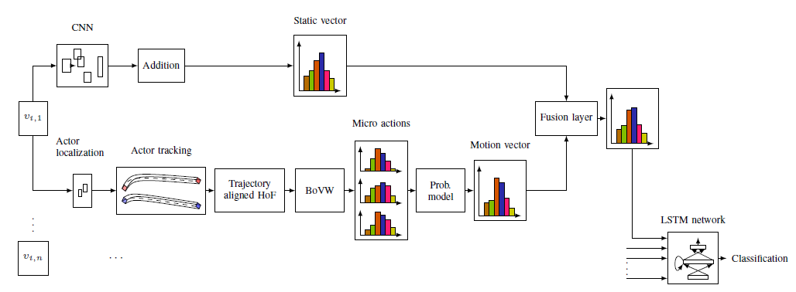
Methodology
Figure – Overview
Notes:
This diagram represents an overview of the end-to-end system.
1 - First, we extract motion features at micro levels, preserving the actor identity, to later obtain a high-level motion descriptor using a probabilistic model.
3 – We train a deep CNN on ImageNet for extracting static features
5 - We propose two novel schemas for combining static and motion features: Cholesky-transformation based and entropy-based.
7 – Then we feed these features to a trained LSTM network and exploit the dynamics of time evolution of the combined vector. Finally, we classify the dynamics of this time series and predict actions.
Now Lets look at each of these sections in depth

Slide 4
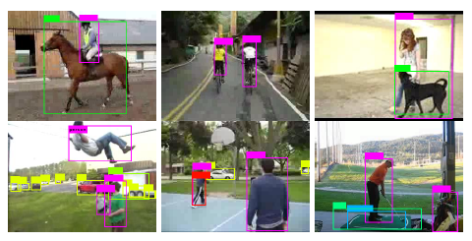
Motion Features
A. Actor Localization
First, split the video in to snippets of 30 frames each.
Then apply the pre-trained detector in Redmon et al [1] on the first frame of each segment and localize the objects and actors.
Figure – Initialization of candidate areas
Notes:
The first step of extracting motion features is to identify the actors in the video, who are responsible for the action. For that,…..
1 – Now one assumption we make here [Redmon detector] is that moving objects and actors do not change inside a duration of 30 frames. The obvious drawback – detect still objects, which do not contribute to the motion activities in the video segment.
3 - Top row – detection of multiple actors
5 - Bottom row – static objects are also detected as candidate areas. Solution – Discard the candidate areas which do not contain significant motion information, now how this is done, I will explain in the next slide

Slide 5
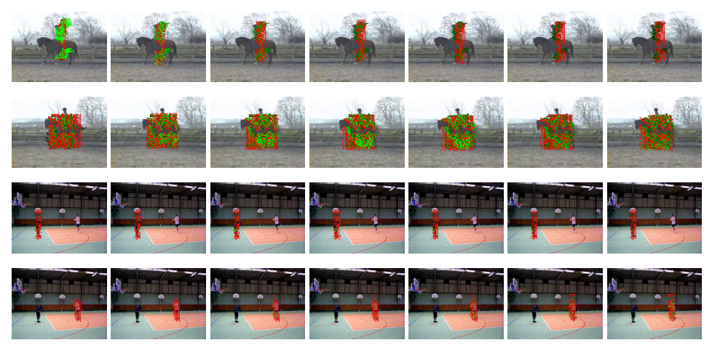
B. Tracking proposed candidate areas
Track the probable moving actors and objects localized in the first frame using Posseger et al [2] up to 30 frames.
Create dense trajectories for each actor or object separately, along with 36-dimensional HOF features.
Figure – Modelling micro actions independently for each actor
Keep only the candidate areas with more than 50 HOF features within a snippet and discard the others
Notes:
Since we have identified who are the potential actors, now we need to track them. We do this using the method described in Possenger up to the 30 frames
2 - The trajectories for the each actor were created in separate iterations, in order to simplify the visualization.
3 – Now, as a solution to the initializing static objects problem identified in the earlier slide, we

Slide 6
C. Modified K-Means for BoW
Choose 100,000 feature points randomly from the pool of HOF features
We modified the k-means clustering by replacing the Euclidean distance by the fractional metric proposed in Aggarwal et al [3], because the standard L₂ norm may be less effective in higher dimensions.
$${dist}_{d}^{f} \left(x,y\right)=\sum_{i=1}^{d}{[((x^{i}−y^{i}))^{f}}]^{\frac{1}{f}}$$
Table – Per class accuracy comparison with state-of-the-art on UCF-11
After clustering the randomly pooled 100,000 HOF feature points, we obtain 1000 cluster heads.
Notes:
0 - Now, to obtain a high-level motion descriptor using a probabilistic model, we need to represent the features using the BoVW representation. BoW on the generated features capture the distributional properties of micro actions.
1 - To reduce the time taken for k-means clustering to identify cluster heads necessary for creating BoWs
4 - We re-implemented the k-means algorithm using three different distance functions: Euclidean, Chi-squared distance, and the fractional metric, and evaluated it on the dataset provided in Franti et al.
5,6 - The results show that the fractional metric, with f = 0:05, performs better.
7 - We choose the number of cluster heads as 1000, because the dimensions of final motion descriptors are needed to be the same as the static descriptors, which is explained in later slides

Slide 7
For each individual object in each video segment v_{i,n}, we calculate the histogram as follows.
$$p_{m}=\underset{jεJ}{argmin_{j}}\left({dist}_{36}^{0.05}\left(T_{j},h_{n,k,m}\right)\right),J=\{1,2,…,1000\}$$
$$h_{n,k,m}−m^{th} HOF vector of k^{th} actor of n^{th} video segment,$$
$$T_{j}−j^{th} cluster head$$
We increment the histogram values as
$$H_{n,k}\left(p_{m}\right)=H_{n,k}\left(p_{m}\right)+1$$
$$H_{n,k}\left(p_{m}\right)−p^{th} value, 1≤p_{m}≤1000,$$
$$of histogram of k^{th}actor of n^{th} video segment$$
Hence, we obtain H_{n}, representing the set of micro actions for n^{th} video segment.
$H_{n}=[H_{1}$, $H_{2}$,…, $H_{k}$]

Slide 8
D. High Level Actions from Micro Actions
We know that
$$H_{n,k}=P(M|A_{k,n})$$
$$M−micro action, A_{k,n}−k^{th} actor in n^{th}video segment$$
Thus, we can obtain the higher level motion descriptor M_{h,n},
$$M_{h,n}=P\left(M | A_{1,n},A_{2,n},…,A_{l,n}\right)=\frac{\prod_{k=1}^{l}{P\left(M | A_{k,n}\right)+α}}{{\left[\frac{1}{k}\sum_{k=1}^{l}{P(M|A_{k,n})}\right]}^{(k−1)}+αk}$$
We empirically use the value α = 1
Notes:
0 – We have merged these vectors in a mathematically meaningful way to obtain a descriptor for the high level action, consisting of these micro actions.
Posterior probability

Slide 9
Static Features
To obtain the static features, we used vggNet with 1000 output classes, pre-trained on ImageNet dataset.
Figure – CNN architecture for generating static features
Apply the trained model on each individual frame of each video segment, and average the output vectors along the indices and obtain a static descriptor s_{i} for each video segment v_{i}.
Hence the static time evolution of the whole video can be represented by the vector time series:
$$S=[s_{1},s_{2},…,s_{n}]$$
Notes:
1 - The CNN consists of five convolution layers, two fully connected layers, and one softmax layer. The details of each convolutional layer are provided on top of each layer according to the following format: (number of convolution layers x filter width x filter height, convolution stride, spatial padding, is Local
Response Normalization added, max-pooling factor). Value above fully connected layers indicates the dimensionality of the layer. We use rectified linear unit (ReLu) as the activation function.

Slide 10
Fusing of Static and Motion Features
Both static and motion information are vital for action recognition.
But, the final accuracy depends on the ratio of contribution of each domain, and the optimum contribution may depend on the richness of the motion information.
A. Cholesky transformation based fusion
$$C=ρ_{2}M+\sqrt{1−ρ_{2}^{2}}S ρ_{2}=\sqrt{1−ρ_{1}^{2}}$$
$$C−Resultant Vector, M−motion vector,S−static vector$$
$$ρ_{1}−Correlation between C and S,ρ_{2}−Correlation between C and M$$
By choosing the value of ρ₁, we can choose the degree to which the static features and the motion features correlate, in deriving the resultant vector.
Notes:
1 – We propose two novel methods to fuse the static and the motion vectors
2 – Many of the known dimensionality reduction technique does not offer the control we desire

Slide 11
B. Entropy based fusion
We model each vector as a histogram, and fit a Gaussian distribution for each, and then compute the joint Gaussian distribution.
$$G_{sm}\left(N\right)=\frac{1}{2πσ_{m}σ_{s}}e^{−[\frac{(N−μ_{s})^{2}}{2σ_{s}^{2}}+\frac{(N−μ_{m})^{2}}{2σ_{m}^{2}}]}$$
Then we calculate the entropies of the both distributions.
$$E\left(X\right)=−\sum{(P(x_{i})\log_{2}{(P\left(x_{i}\right)))}}$$
The axis of the joint probability can be scaled using the scaling matrix,
$$Scaling matrix=\left[\begin{matrix}\frac{E(S)}{E\left(M\right)+E(S)} & 0 \\ 0 & \frac{E(M)}{E\left(M\right)+E(S)}\end{matrix}\right]$$
UCF-11 ← 13% Motion + 87% Static, Hollywood2 ← 17% Motion + 83% Static
Notes:
1 - According to information theory, the amount of information contained in a histogram is proportional to the entropy of the distribution.
2 - This enables us to give weighted contribution from each domain to the final vector, based on the information content. The parameters of the scaling matrix defines how much each domain contributes to the evaluation line of the joint distribution. 𝐸(𝑀)−𝐸𝑛𝑡𝑟𝑜𝑝𝑦 𝑜𝑓 𝑡ℎ𝑒 𝑀𝑜𝑡𝑖𝑜𝑛 𝑣𝑒𝑐𝑡𝑜𝑟, 𝐸(𝑆)−𝐸𝑛𝑡𝑟𝑜𝑝𝑦 𝑜𝑓 𝑡ℎ𝑒 𝑆𝑡𝑎𝑡𝑖𝑐 𝑣𝑒𝑐𝑡𝑜𝑟
Therefore, the optimum ratio for combination of motion and static components of a given dataset can be mathematically evaluated.
3 - With regards to the UCF-11, 13% of motion vector and 87% of static vector constitute this parameter on average. For Hollywood2, it is 17% and 83%.

Slide 12
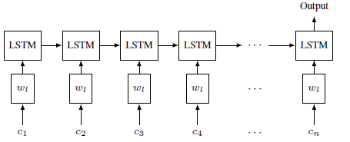
Capturing Temporal Evolution
We represent each video as n fixed-length segments with overlapping frames.
Each segment is represented with a fused vector c_{t}. Therefore, each video can be represented as a vector time series.
Figure – Feeding fused vectors to the LSTM network
Notes:
0 - n differs for videos of different lengths
2 - We model and classify this time series by feeding the fused vectors to a LSTM network. The network consists of an input layer, a 128 unit LSTM layer with 0.8 dropout, and a fully connected softmax output layer.

Slide 13
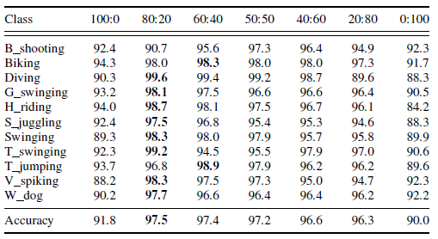
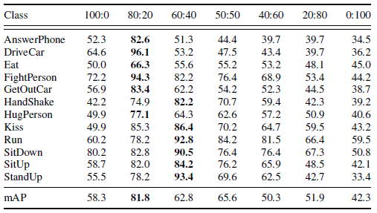
Experiments and Results
We use two benchmark datasets to evaluate our system: UCF-11 and Hollywood2
A. Contribution of Static and Motion Domains
The optimum contribution depends on the scenario. If motion patterns are indistinguishable across actions, static information plays a critical role for determining the action, and vice versa.
Table – Per class accuracy for UCF-11
Table – mAP per class for Hollywood2
Notes:
5 - for action classes which do not highly interact with external objects—such as, kiss, run, sitdown, situp, standup —the optimum motion:static ratio is 40:60.
6 - For other action classes, which interact with objects, optimum motion:static ratio is 20:80. This highlights our hypothesis, that being able to control this contribution explicitly, is vital for an action recognition system.
8 – The overall optimum contribution ratio between static and motion vectors for both datasets, in average, stand at 80:20
9 - Our mathematical derivation of optimum contribution ratio as 87:13 and 83:17 for UCF-11 and Hollywood2 datasets closely aligns with the experimental values of 80:20, further verifying our results.

Slide 14
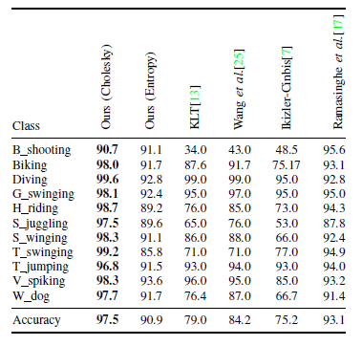
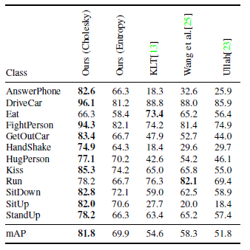
Experiments and Results
B. Comparison with the State-of-the-Art
Table – Per class accuracy for UCF-11
Table – mAP per class for Hollywood2
Notes:
2 - On UCF-11, we significantly outperform the state-of-the-art by 4.4% while on Hollywood2 we outperform the state-of- the-art by 23.5%
6 - In UCF-11, our method excels in all the 11 classes,
8 - while in Hollywood2 we excel in 10 out of 12 classes.

Slide 15
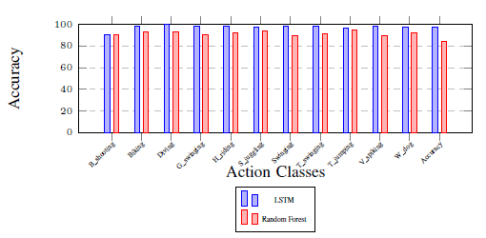
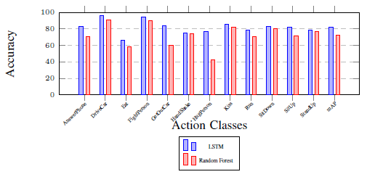
Experiments and Results
C. Effectiveness of Capturing time evolution
Figure – Accuracy comparison between
Random Forrest Classifier and LSTM
for UCF-11
Figure – mAP comparison between
Random Forrest Classifier and LSTM
For Hollywood2
Notes:
1 - For comparison, we also directly feed the fused vectors to a random forest classier, which does not capture sequential dynamic patterns. The LSTM network signicantly outperforms the random forest classier for both datasets.
Thus, we verify the significant impact of temporal patterns of sub activities on complex action classification.

Slide 16
Limitations and Future work
The system is not yet end-to-end trainable.
It is better if segmentation of sub-events was performed in a semantically meaningful manner.
No significance given to the prominent actor

Slide 17
Thank You!
References
[1] H. Possegger, T. Mauthner, and H. Bischof. In defense of colorbased model-free tracking. In Proceedings of the IEEE Conference on Computer Vision and Pattern Recognition, pages 2113–2120, 2015.
[2] J. Redmon, S. Divvala, R. Girshick, and A. Farhadi. You only look once: Unified, real-time object detection. In Proceedings of the IEEE Conference on Computer Vision and Pattern Recognition, pages 779–788, 2016.
[3] C. C. Aggarwal, A. Hinneburg, and D. A. Keim. On the surprising behavior of distance metrics in high dimensional space. In International Conference on Database Theory, pages 420–434. Springer, 2001.

